Slide 1
More on Evaluating Research

Slide 2
Strack et al. (1988)
Inhibiting and facilitating conditions of the human smile: A nonobtrusive test of the facial feedback hypothesis. Journal of Personality and Social Psychology
Study 1
What is the study about?
Facial feedback hypothesis
People’s affective responses can be influenced by their own facial expression (e.g. smiling, pouting)
Participants rated cartoons while holding a pen with their mouth.

Slide 3
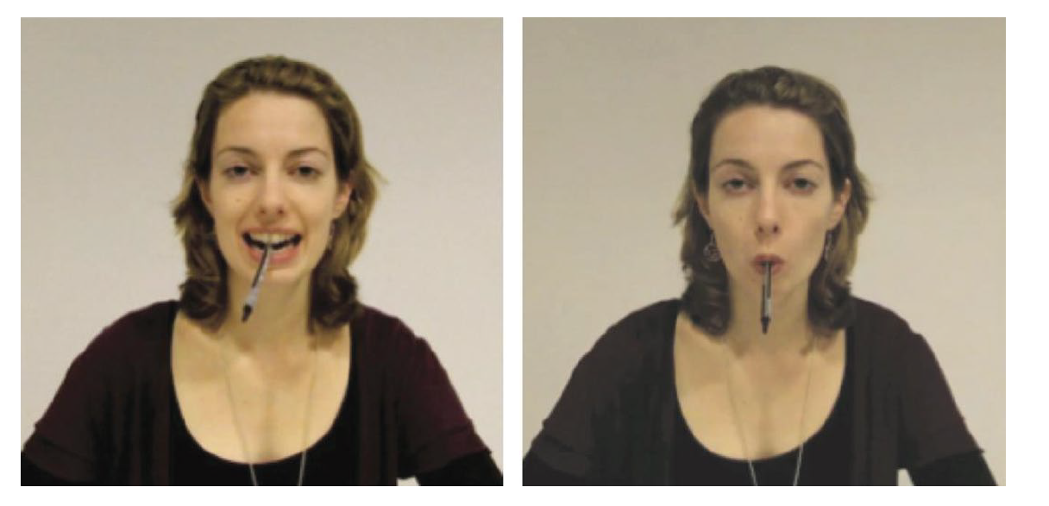
Strack et al. (1988)
Can smiling actually make us happier? Does frowning actually make us sad?

Slide 4
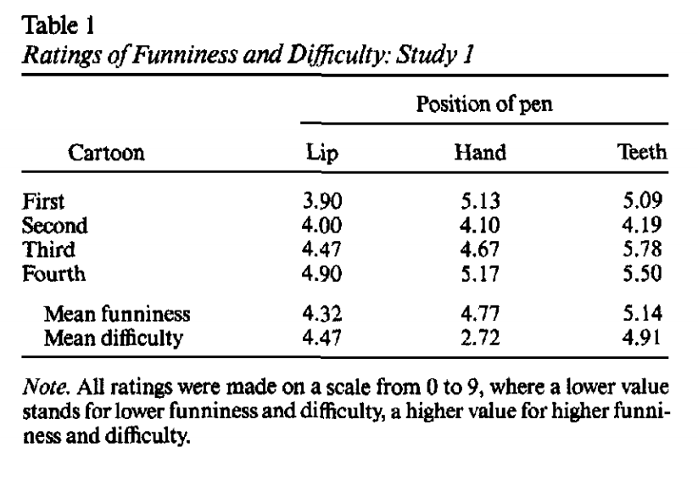

Strack et al. (1988)
IV
How participants held the pen, either with their teeth, or with their lips
DV
Cartoon ratings (how funny)
What did they find?
People rate cartoons as funnier with pen held in their teeth vs. lips

Slide 5
Do you believe this finding?
~ 30 per group (that’s okay)
On the surface, it seems like the study was done okay
(although their second study was underpowered… for a discussion see http://datacolada.org/17)
Well… there was a replication attempt of this

Slide 6
Wagenmakers et al. (2016)
Registered Replication Report – direct replication attempt of the facial feedback hypothesis
17 independent labs
Pre-registered their hypothesis, made their analysis plan before they collected data, and placed all of their data and materials online for free (OSF)

Slide 7
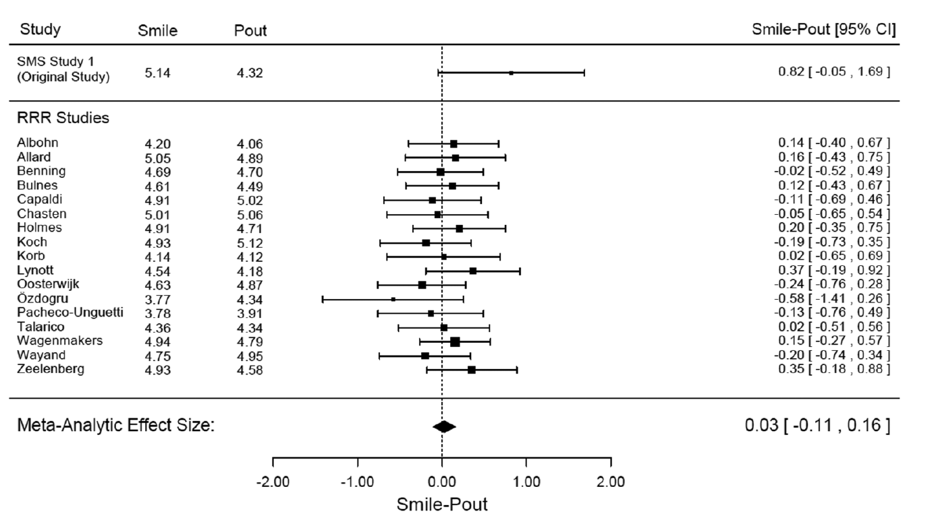

Slide 8
Wagenmakers et al. (2016)
“Results: Exploratory Analyses”
“This RRR did not replicate the SMS result and failed to do so in a statistically compelling fashion. Nevertheless, it should be stressed that the RRR results do not invalidate the more general facial feedback hypothesis. It is possible that the original SMS paradigm that we employed does not provide a strong test of the facial feedback hypothesis and that other procedures would provide more compelling evidence.”

